Slide 1


GPU optimization techniques and tools
A collection of ideas to maybe improve your GPU performance
*Presented data acquired over a two years period of hands-on experimentation and accumulated frustration and suffering.
Miguel De Le Court
UCLouvain, IMMC

Slide 2
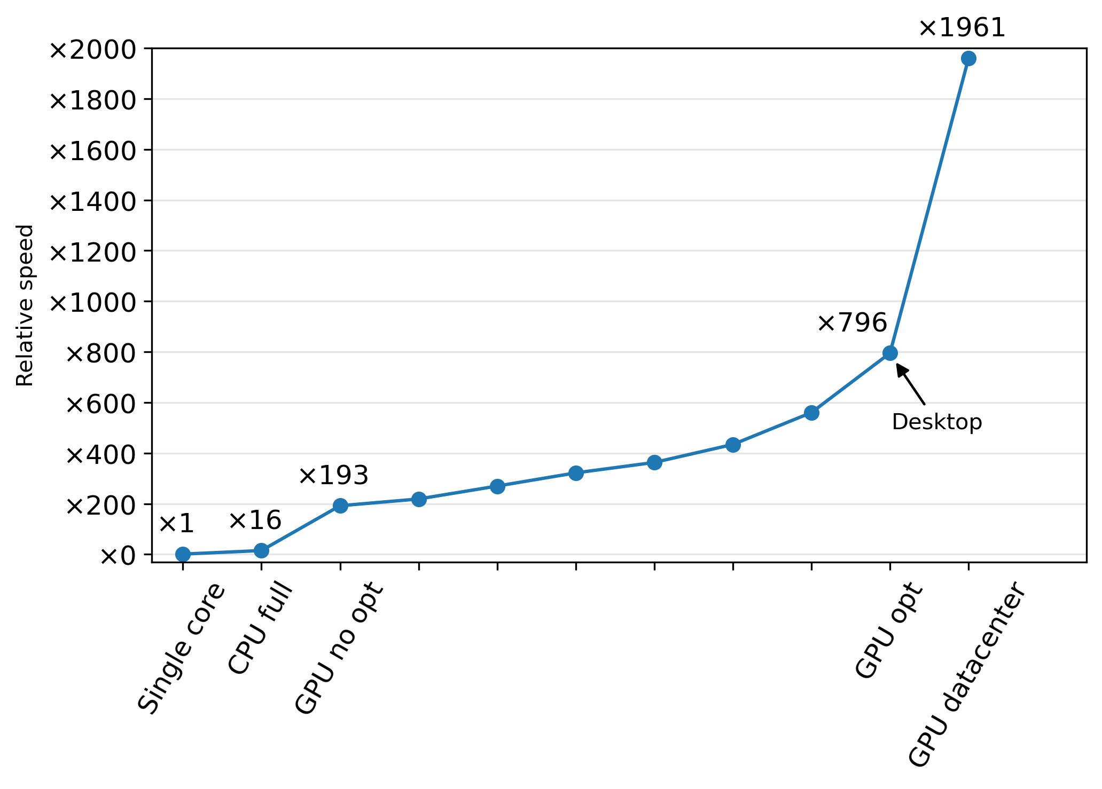
The importance of using GPU resources effectively
Big gap between a naïve porting of a CPU-optimized code and a GPU-optimized code
Writing efficient GPU code is HARD
When it works : it’s very fast
Our journey today

Slide 3
Plan for this session
0. What is a GPU
double vs float
Locality
Coalescence
double literals
Occupancy limiters
Kernel fusion
Shared memory
Array of struct of array
Free compiler flags

Slide 4
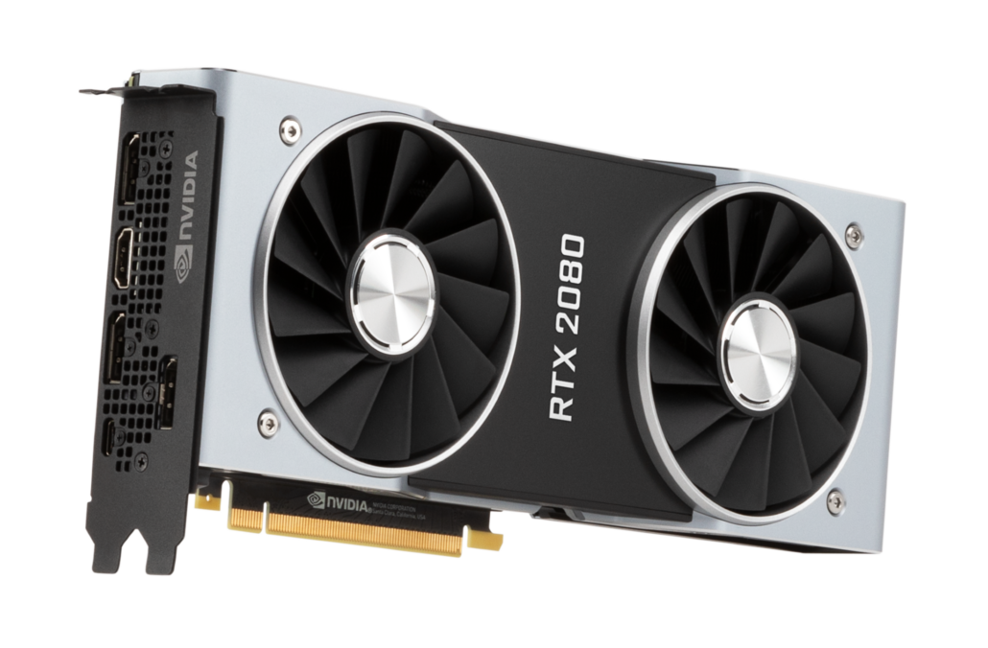
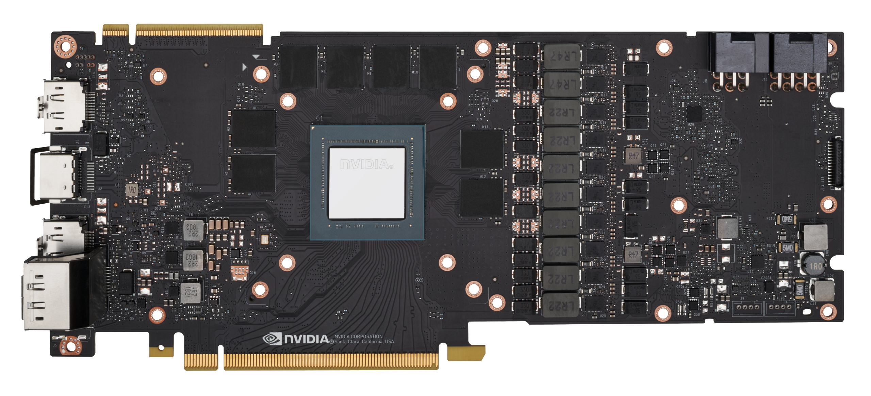
What is a GPU ?
Some differences VS a CPU include
SIMD-like execution model
Coalescent memory access
Very high memory latency
Designed for higher arithmetic intensity
Very limited cache per thread
…

Slide 5
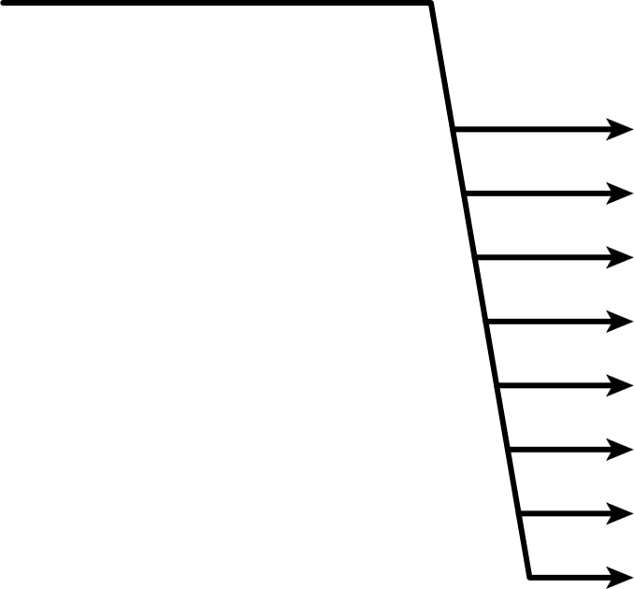
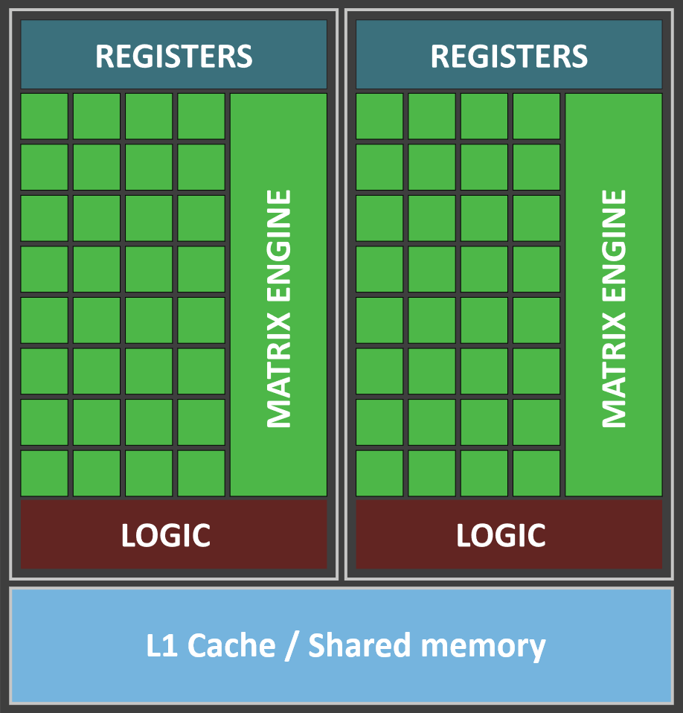
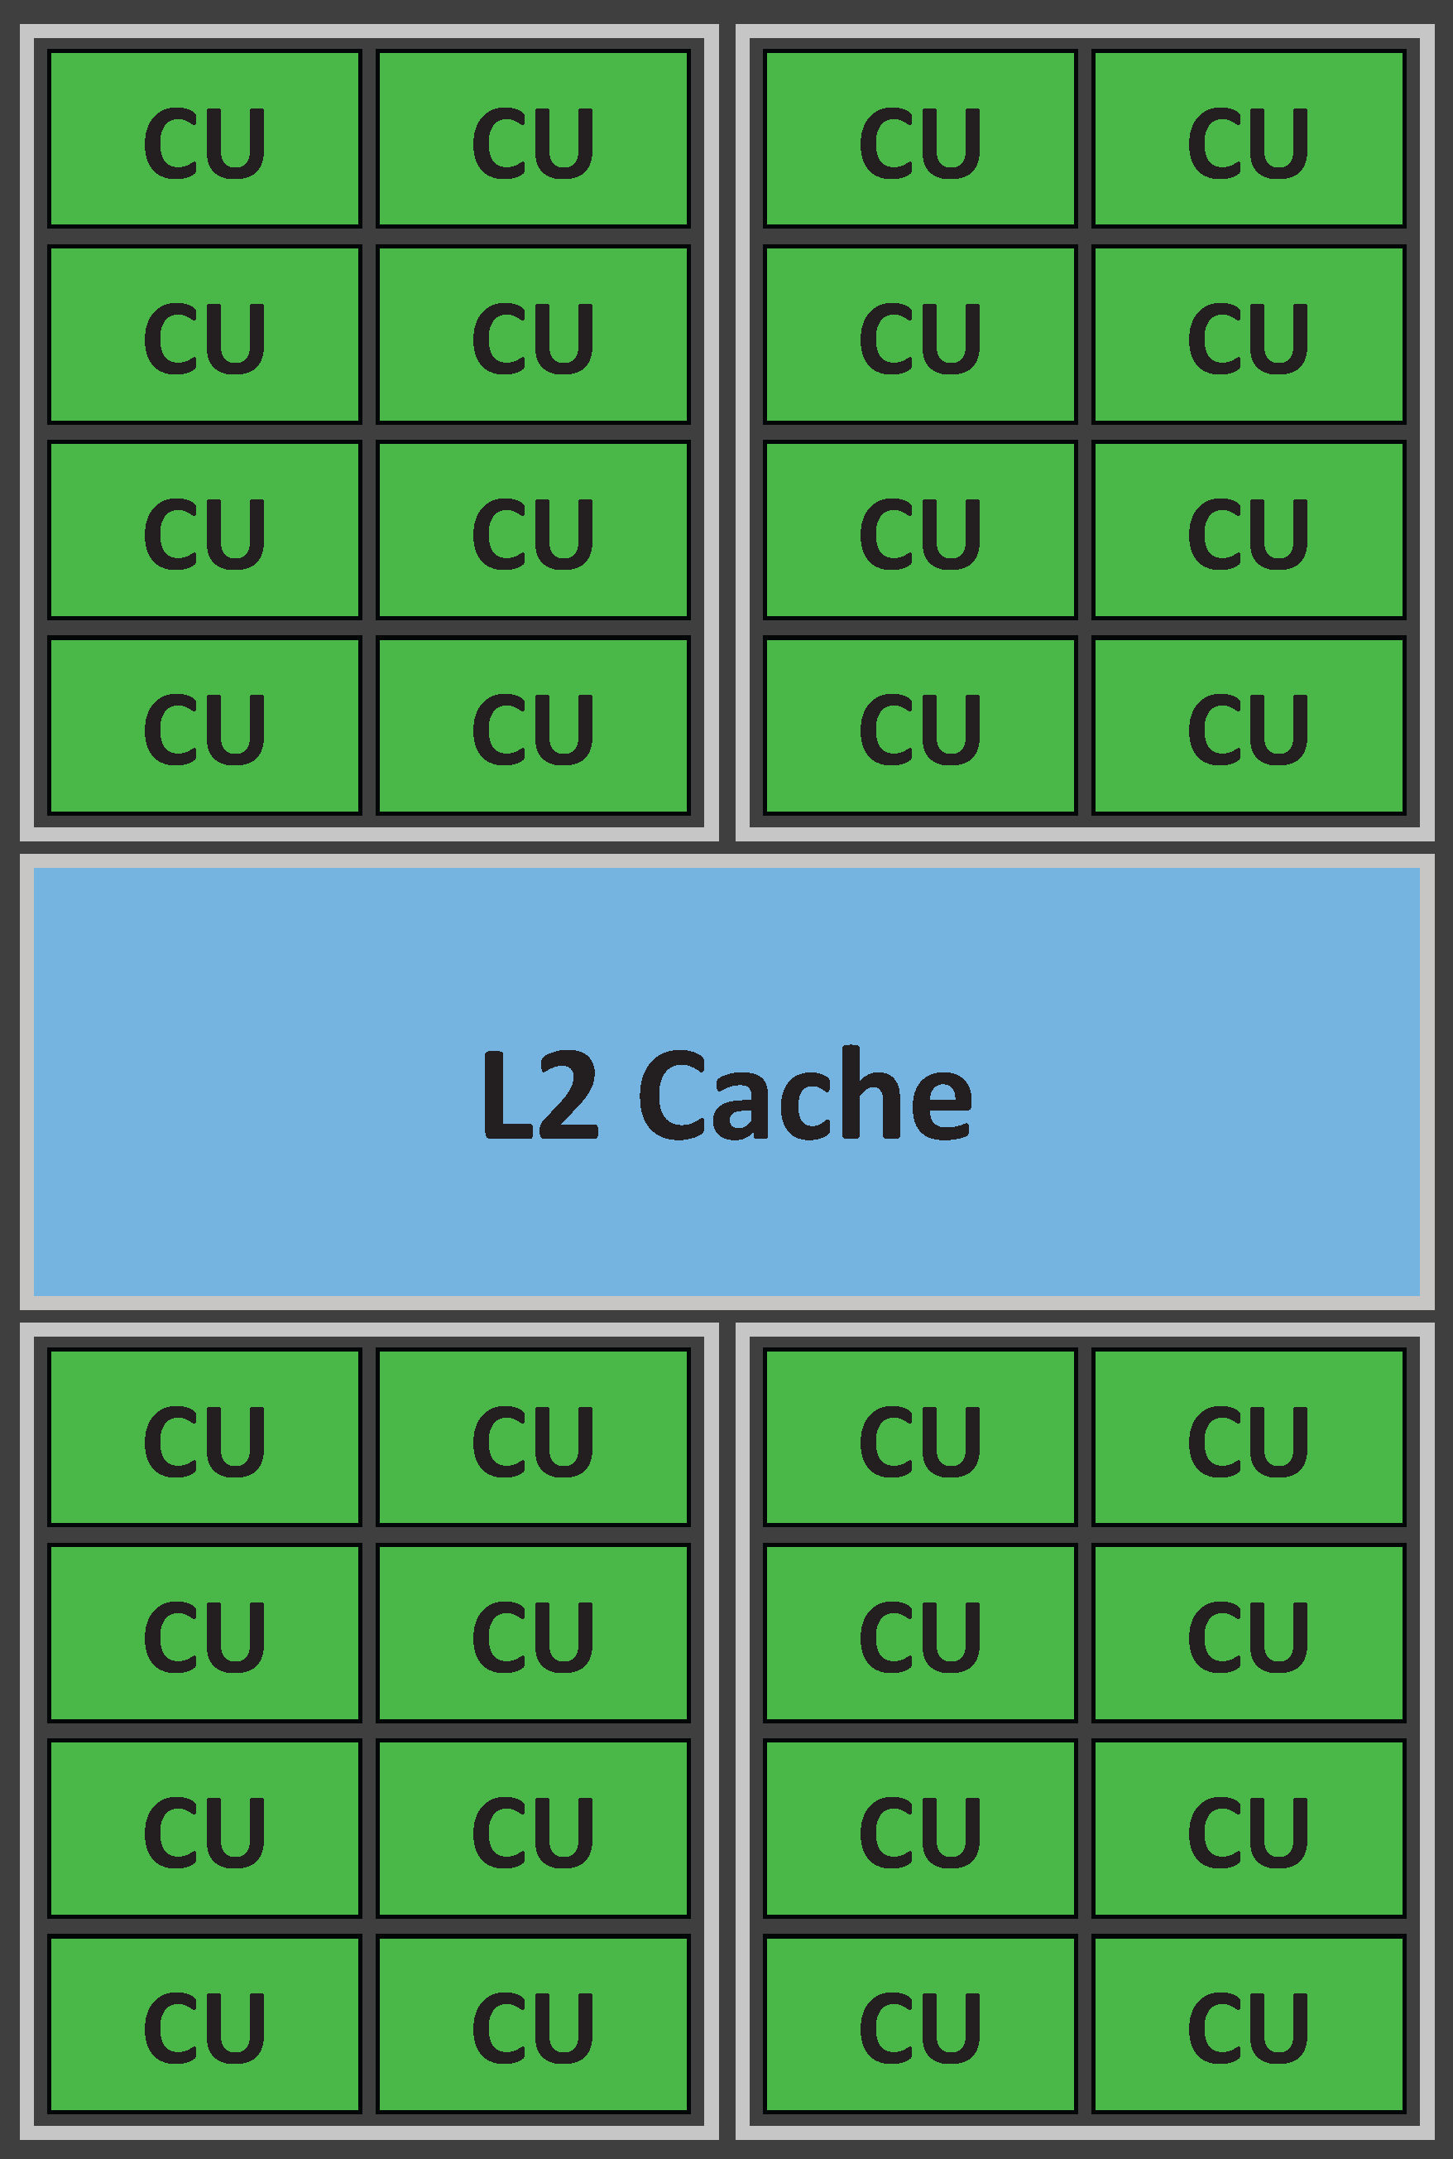
What is a GPU : the execution model
Defining characteristics:
Cores of a CU¹ are not independent
Computations inside of a CU¹ is the same for all threads
No data exchange and synchronisation² outside of the CU. Compute units are completely independent
Cores in a CU want to access data from the same “cache line” : coalescence
Many GPU cores
Compute Unit (CU)
Simplified GPU
Zoom on a compute unit

Slide 6
Nomenclature
Green = NVIDIA
Blue = INTEL
Red = AMD
(Cuda) cores = Shading Units = Stream processors
Streaming multiprocessor = Core = Compute Unit
Simplified GPU
Zoom on a compute unit

Slide 7
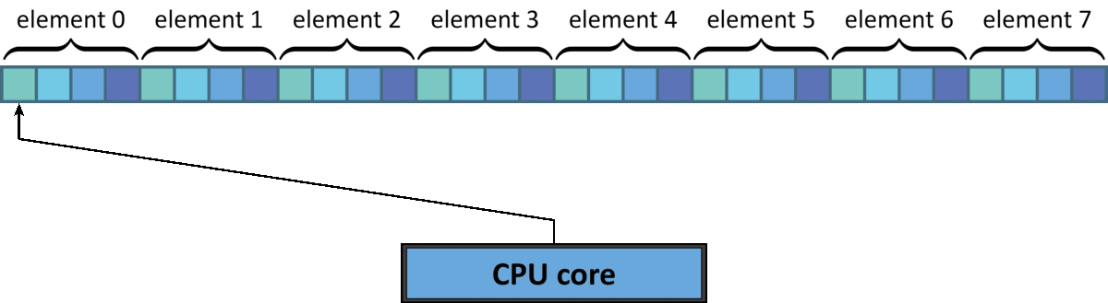
Coalescent memory access
On the CPU : we want to maximize locality

Slide 8
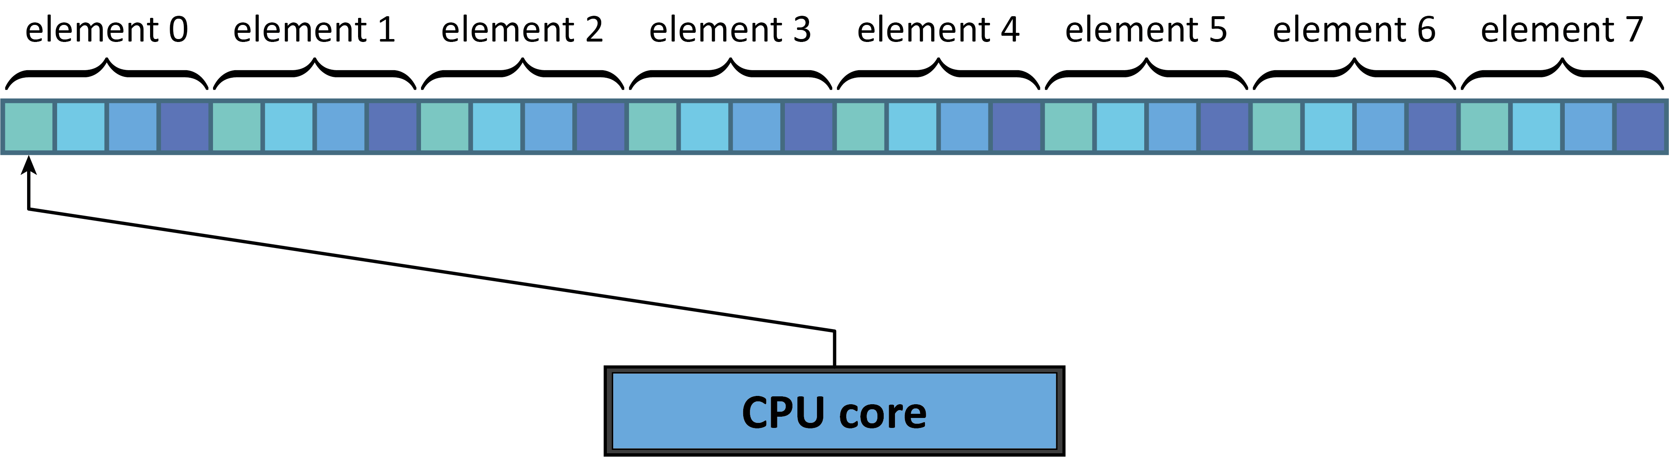
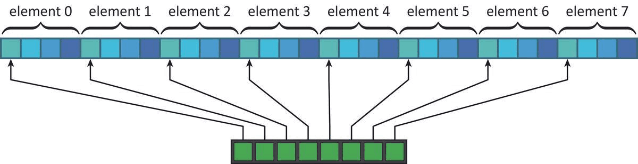
Coalescent memory access
On the CPU : we want to maximize locality
On the GPU : data is accessed simultaneously
Much smaller cache per core : data may not fit! → Excessive loads
compute unit

Slide 9
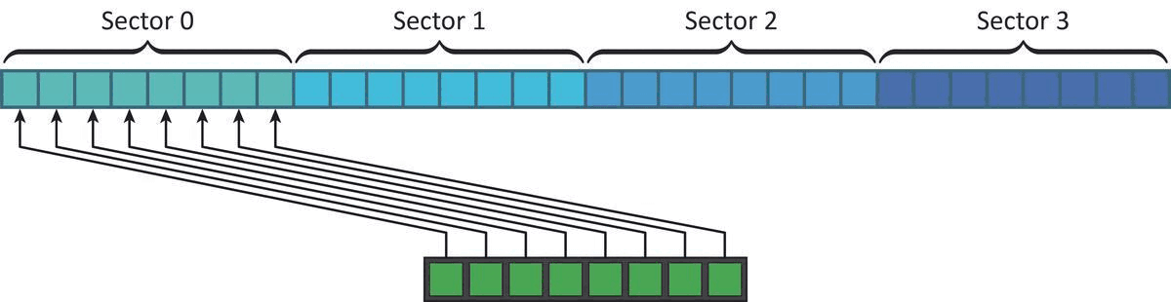
Coalescent memory access
On the CPU : we want to maximize locality
On the GPU : data is accessed simultaneously
Much smaller cache per core : data may not fit! → Excessive loads
Optimal pattern : all cores from a CU read same sector : One sector read per access
compute unit

Slide 10

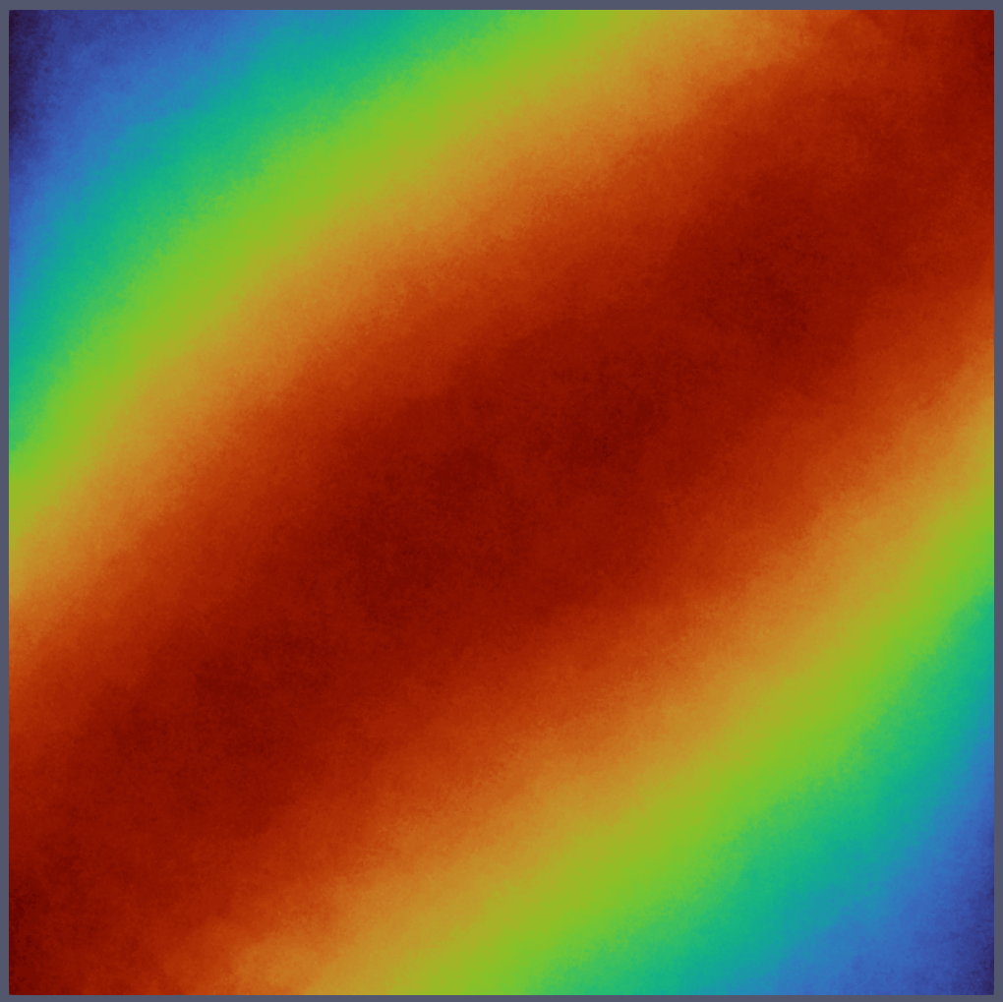
1 – Double vs float : which one should you choose, and why is it float*?
RTX3080:
Float : 29.77 TFLOPS
Double : 0.47 TFLOPS
A100:
Float : 19.49 TFLOPS
Double : 9.746 TFLOPS
If you can, use floats
Double
Float

Slide 11
Where is the bottleneck ?
void dudt(const float* u, float* fu, ...){
for(int i = 0; i < n; i++){
// loading data
float[4][3] local_u;
local_u[...] = u[...]; // some heavy computation
// writing back the result
fu[...] = local_fu;
}
}
4%
Heavy processing
95%
1%

Slide 12
Where is the bottleneck ?
__global__ void dudt_kernel(const float* u, float* fu, ...){
int tid = threadIdx.x + blockIdx.x * blockDim.x;
if (tid < n){
// loading data
float[4][3] local_u;
local_u[...] = u[...]; // some heavy computation
// writing back the result
fu[...] = local_fu;
}
}
Heavy processing

Slide 13
Memory is (almost always) the bottleneck
__global__ void dudt_kernel(const float* u, float* fu, ...){
int tid = threadIdx.x + blockIdx.x * blockDim.x;
if (tid < n){
// loading data
float[4][3] local_u;
local_u[...] = u[...]; // some heavy computation
// writing back the result
fu[...] = local_fu;
}
}
55%
Heavy processing
30%
15%

Slide 14
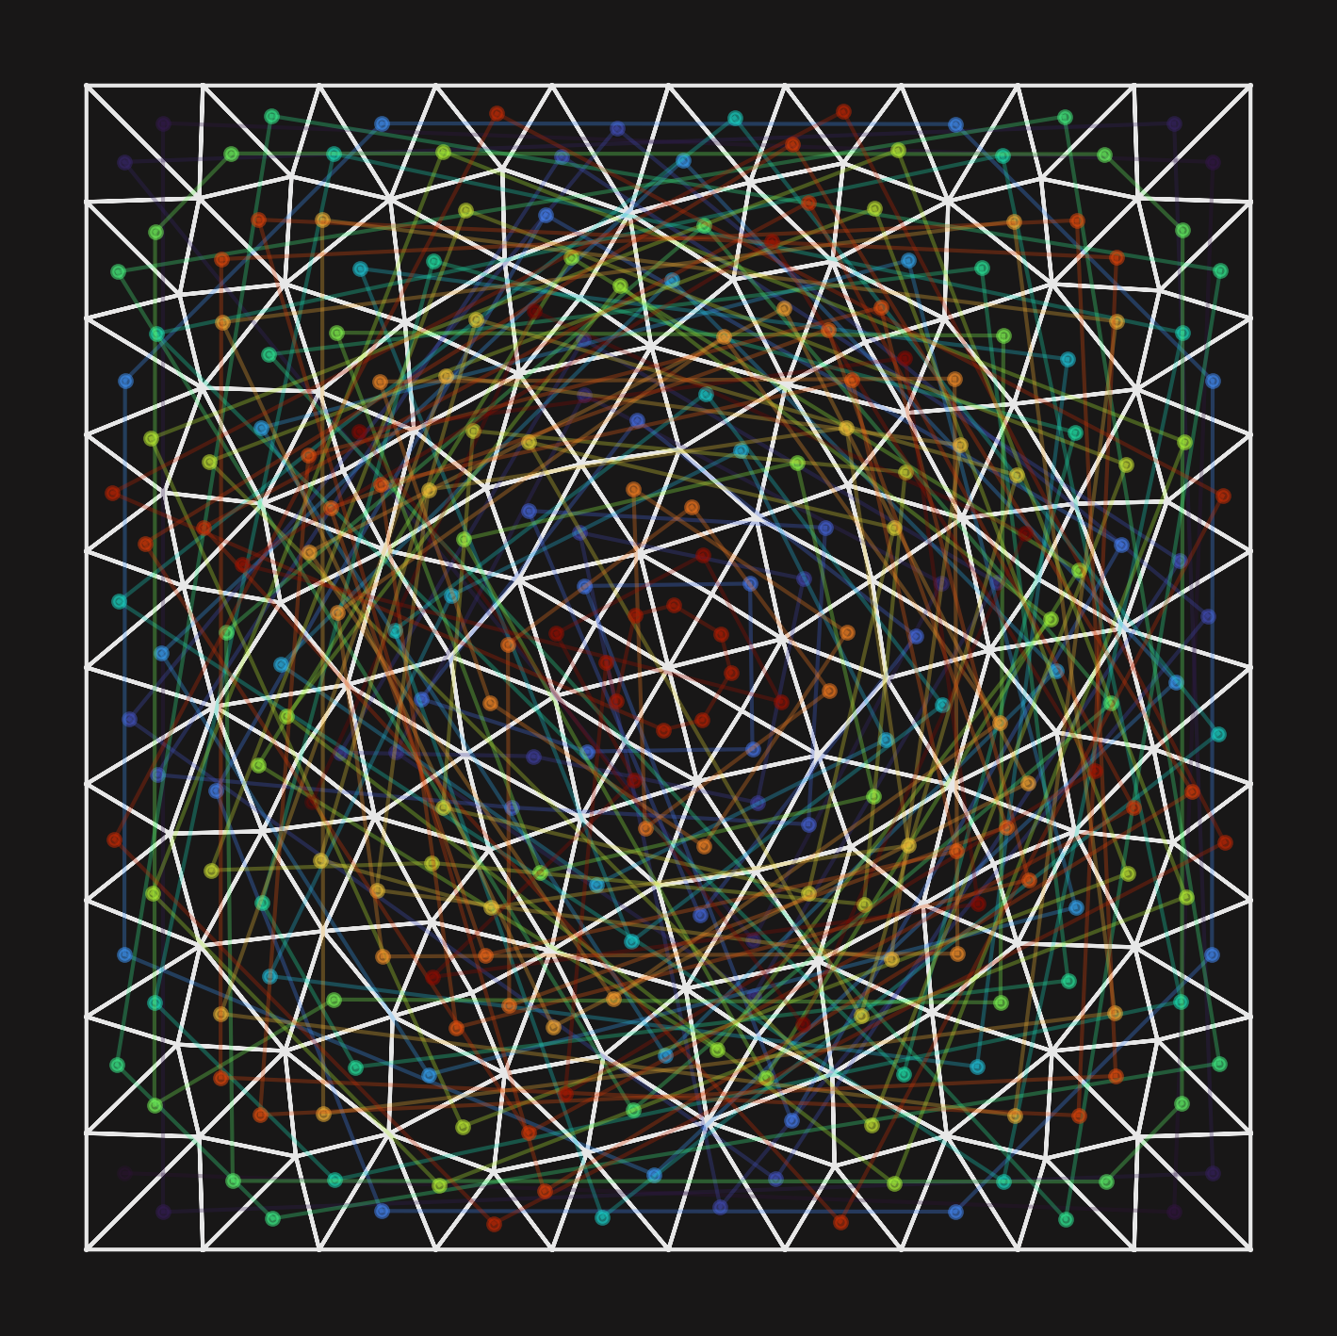
2 – Importance of memory locality
GPU MEMORY
Cache
12
68
42
115

Slide 15
2 – Importance of memory locality
GPU MEMORY
Cache
12
68
42
115

Slide 16
2 – Importance of memory locality
GPU MEMORY
Cache
12
68
42
115

Slide 17
2 – Importance of memory locality
GPU MEMORY
Cache
12
68
42
115

Slide 18
2 – Importance of memory locality
GPU MEMORY
Cache
12
68
42
115

Slide 19
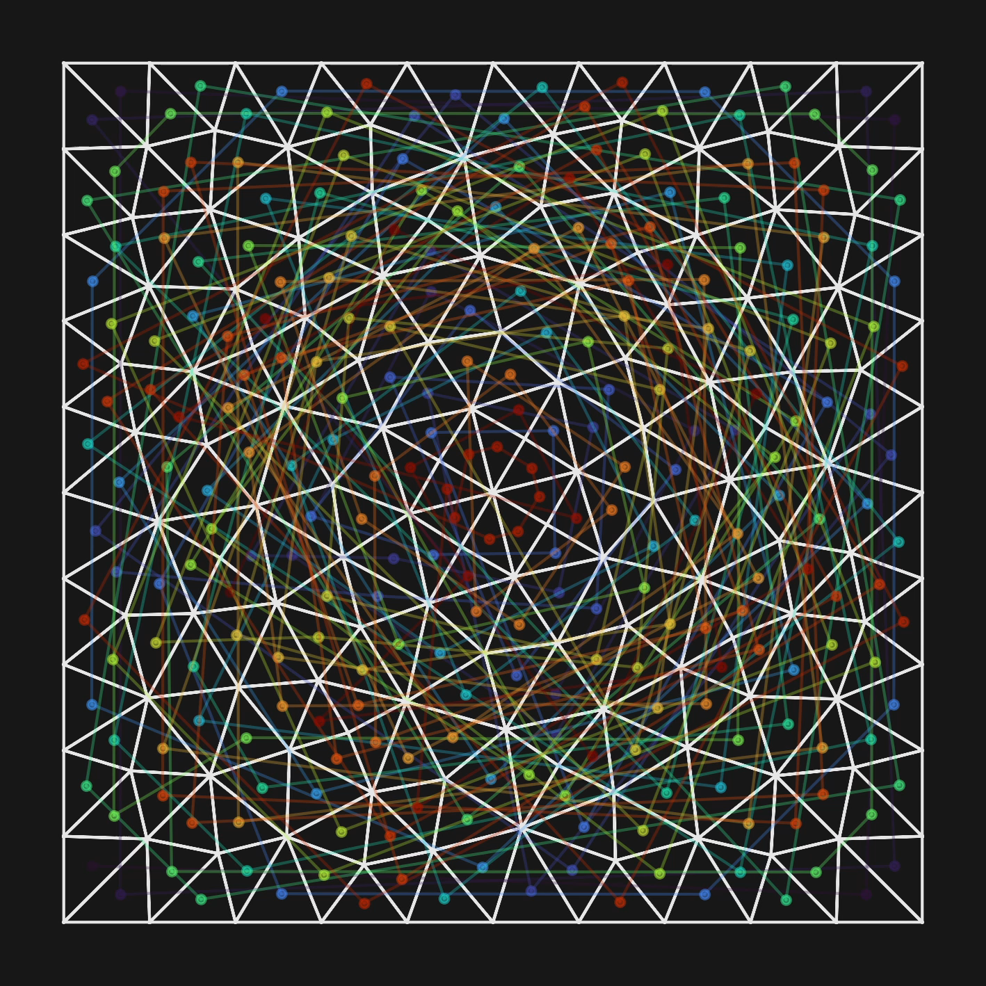
2 – Importance of memory locality
GPU MEMORY
Cache
12
68
42
115

Slide 20
2 – Importance of memory locality
GPU MEMORY
Cache
40
58
43
48

Slide 21
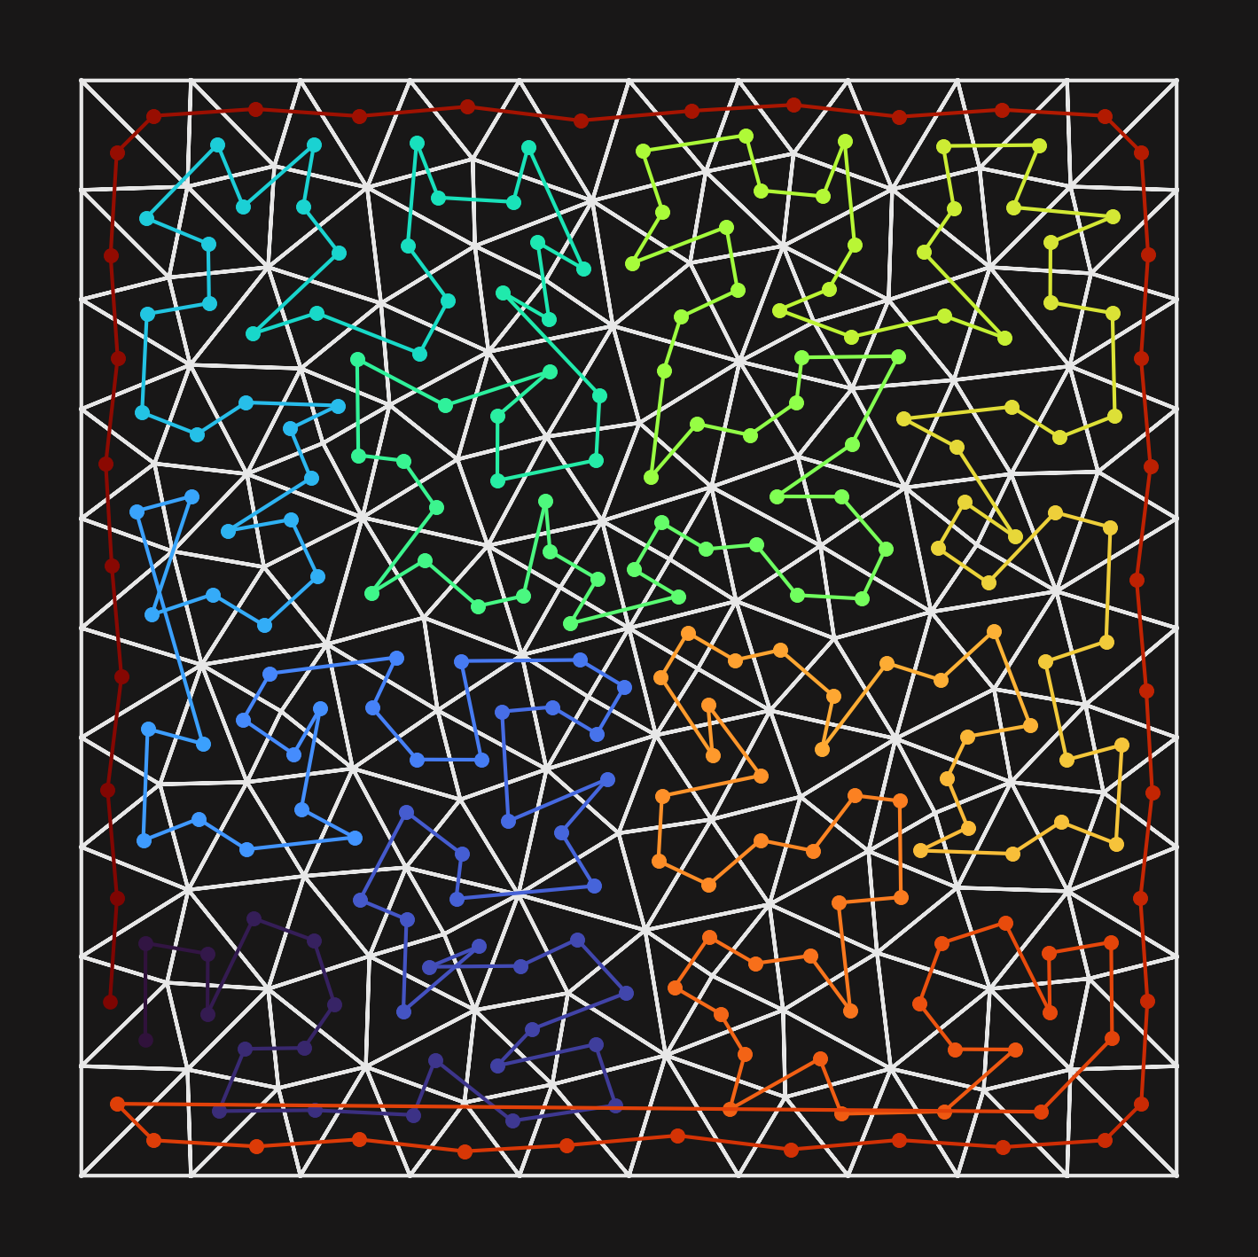
2 – Importance of memory locality
GPU MEMORY
Cache
40
58
43
48

Slide 22
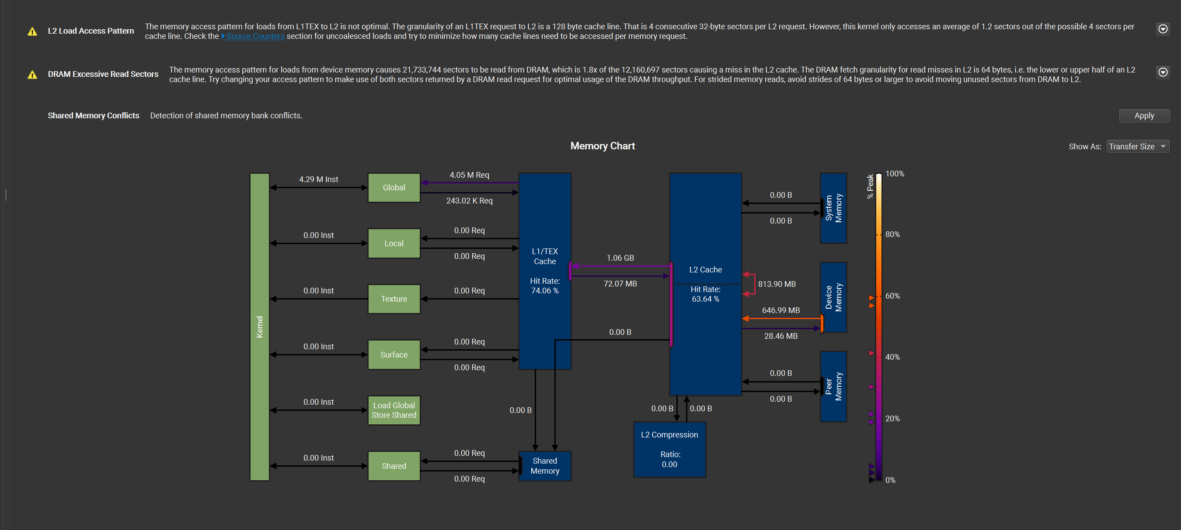
2 – Clues to detect that problem:
Very high bandwidth utilization
Too many reads compared to what is expected

Slide 23
3 – So… let’s optimize for locality, right ?
__global__ void mysum(const float* a, const float* b, float* c, int nf, int n){
int tid = threadIdx.x + blockIdx.x * blockDim.x;
if (tid < n){
for(int field = 0; field < nf; field++){
// maximal locality
c[tid * nf + field] = a[tid * nf + field] + b[tid * nf + field];
}
}
}
__global__ void mysum(const float* a, const float* b, float* c, int nf, int n){
int tid = threadIdx.x + blockIdx.x * blockDim.x;
if (tid < n){
for(int field = 0; field < nf; field++){
// very large stride
c[field * n + tid] = a[field * n + tid] + b[field * n + tid];
}
}
}

Slide 24
3 – No, we need to consider coalescence
__global__ void mysum(const float* a, const float* b, float* c, int nf, int n){
int tid = threadIdx.x + blockIdx.x * blockDim.x;
if (tid < n){
for(int field = 0; field < nf; field++){
// maximal locality
c[tid * nf + field] = a[tid * nf + field] + b[tid * nf + field];
}
}
}
634 µs
__global__ void mysum(const float* a, const float* b, float* c, int nf, int n){
int tid = threadIdx.x + blockIdx.x * blockDim.x;
if (tid < n){
for(int field = 0; field < nf; field++){
// very large stride
c[field * n + tid] = a[field * n + tid] + b[field * n + tid];
}
}
}
403 µs

Slide 25

3 – No, we need to consider coalescence
__global__ void mysum(const float* a, const float* b, float* c, int nf, int n){
int tid = threadIdx.x + blockIdx.x * blockDim.x;
if (tid < n){
for(int field = 0; field < nf; field++){
// maximal locality
c[tid * nf + field] = a[tid * nf + field] + b[tid * nf + field];
}
}
}
__global__ void mysum(const float* a, const float* b, float* c, int nf, int n){
int tid = threadIdx.x + blockIdx.x * blockDim.x;
if (tid < n){
for(int field = 0; field < nf; field++){
// very large stride
c[field * n + tid] = a[field * n + tid] + b[field * n + tid];
}
}
}

Slide 26
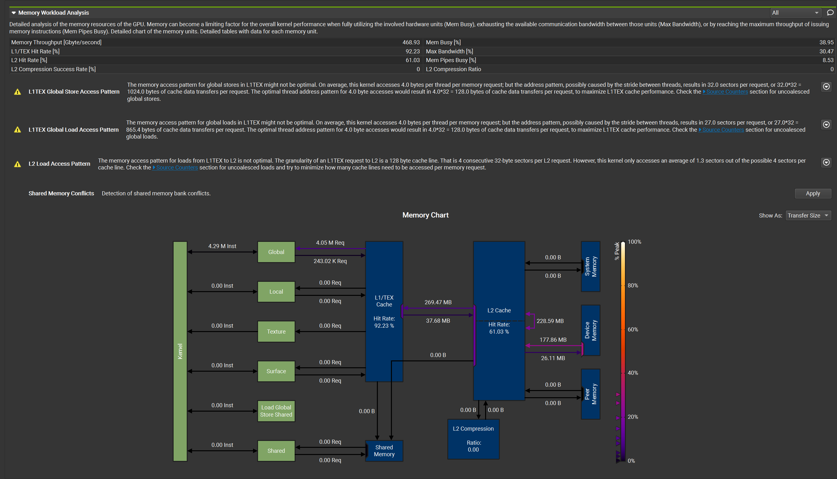
3 – How to evaluate if coalescence is good ?
ncu will yell at you if it’s not

Slide 27
4 – Beware of doubles
__device__ float inv2x2(const float mat[2][2], float inv[2][2])
{
float det = det2x2(mat);
float ud = 1.0 / det;
inv[0][0] = mat[1][1] * ud;
inv[1][0] = -mat[1][0] * ud;
inv[0][1] = -mat[0][1] * ud;
inv[1][1] = mat[0][0] * ud;
return det;
}

Slide 28
4 – Beware of doubles
__device__ float inv2x2(const float mat[2][2], float inv[2][2])
{
float det = det2x2(mat);
float ud = 1.0f / det;
inv[0][0] = mat[1][1] * ud;
inv[1][0] = -mat[1][0] * ud;
inv[0][1] = -mat[0][1] * ud;
inv[1][1] = mat[0][0] * ud;
return det;
}

Slide 29
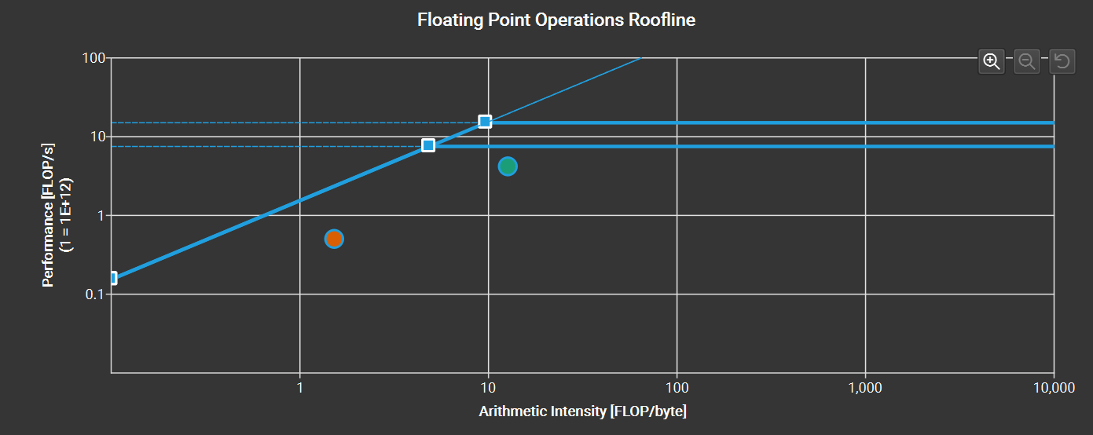
4 – Beware of doubles : how to check?

Slide 30
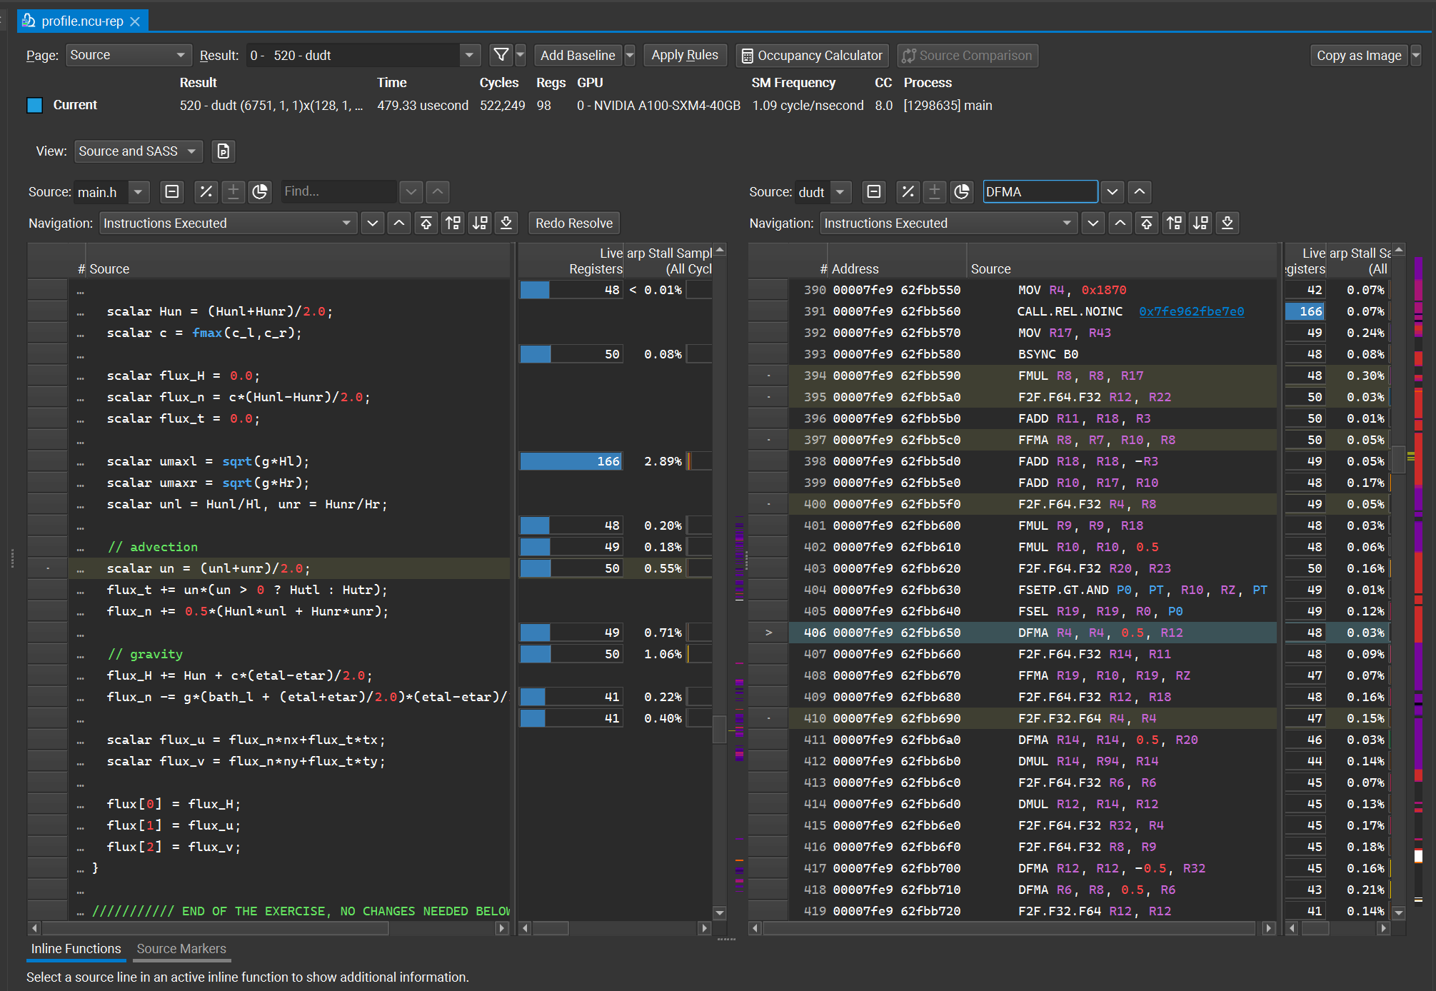
4 – Beware of doubles : how to check?
Look for DMUL, DFMA
Code must be compiled with -–generate-line-info

Slide 31
5 – Why did a simple printf make my code 1.2x slower ?
__device__ float inv2x2(const float mat[2][2], float inv[2][2])
{
float det = det2x2(mat);
if(det){
float ud = 1.0 / det;
inv[0][0] = mat[1][1] * ud;
inv[1][0] = -mat[1][0] * ud;
inv[0][1] = -mat[0][1] * ud;
inv[1][1] = mat[0][0] * ud;
}
else{
printf("Singular matrix 2x2");
for(int i = 0; i < 2; i++)
for(int j = 0; j < 2; j++)
inv[i][j] = 0.0;
}
return det;
}

Slide 32
5 – Why did a simple printf make my code 1.2x slower ?
__device__ float inv2x2(const float mat[2][2], float inv[2][2])
{
float det = det2x2(mat);
float ud = 1.0 / det;
inv[0][0] = mat[1][1] * ud;
inv[1][0] = -mat[1][0] * ud;
inv[0][1] = -mat[0][1] * ud;
inv[1][1] = mat[0][0] * ud;
return det;
}

Slide 33
5 – Watch the occupancy!
__device__ float inv2x2(const float mat[2][2], float inv[2][2])
{
float det = det2x2(mat);
if(det){
float ud = 1.0 / det;
inv[0][0] = mat[1][1] * ud;
inv[1][0] = -mat[1][0] * ud;
inv[0][1] = -mat[0][1] * ud;
inv[1][1] = mat[0][0] * ud;
}
else{
printf("Singular matrix 2x2");
for(int i = 0; i < 2; i++)
for(int j = 0; j < 2; j++)
inv[i][j] = 0.0;
}
return det;
}

Slide 34
5 – Watch the occupancy!
__device__ float inv2x2(const float mat[2][2], float inv[2][2])
{
float det = det2x2(mat);
float ud = 1.0 / det;
inv[0][0] = mat[1][1] * ud;
inv[1][0] = -mat[1][0] * ud;
inv[0][1] = -mat[0][1] * ud;
inv[1][1] = mat[0][0] * ud;
return det;
}

Slide 35
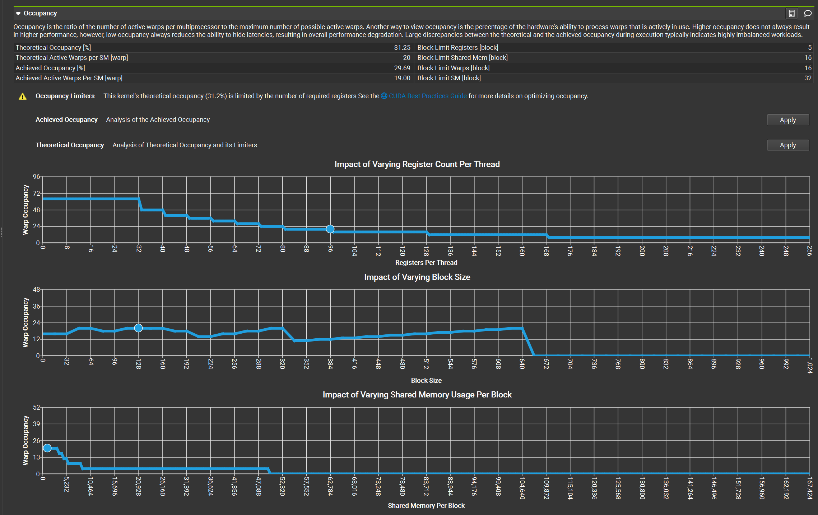
5 – Is the occupancy a limiting factor?
ncu will tell you
Often the case that occupancy is limited by registers, but critical when « on a step »
Can sometimes be mitigated by template kernel specialization

Slide 36
Exercice time!
Use floats
Use a reordered mesh
Transpose the memory access for more coalescence (at the price of locality though!)
Catch the remaining double literals
Remove the never-accessed debug print code
File : main.h

Slide 37
6 – Kernel fusion
Kernels comparable in duration
Kernels share variables
Makes sense to merge the kernels to avoid a read and write from global memory
Timeline

Slide 38
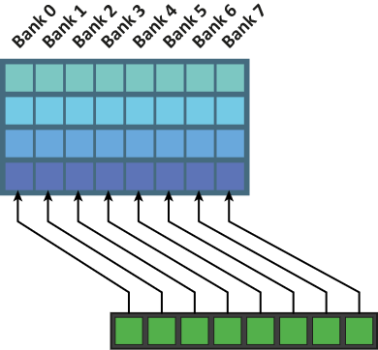
7 – Using shared memory
To share data among threads
To manually cache some frequently used data
To reduce register pressure/ local memory usage
To allow communication/ data exchange within a group
Shared memory organzed in « Banks »
Simultaneous accesses to the same bank are serialized
Consecutive threads should access consecutive banks

Slide 39
8 – Array of struct of arrays
Array of struct : perfect locality, bad coalescence
Struct of array : good coalescence, bad locality
What if we could combine both? Array-of-struct-of-array layout : good coalescence, fairly good locality

Slide 40
9 – Free performance*?
--use_fast_math : compiler flag that enables unsafe and less accurate but sometimes faster math (Can reduce register usage significantly)
--extra-device-vectorization
__launch_bounds__() : Tell the compiler the maximum block size at compile time. Allow optimization that can significantly improve the performance, or sometimes significantly worsen the performance. Usage :
__launch_bounds__(BLOCK_SIZE)
__global__ void my_kernel(float a, float* data, int n){...
*Sometimes

Slide 41
All of these are just ideas:
Some things may work and improve the performance,
Others may slow down the code.
Some can degrade the quality of the solution,
Some may not be possible due to resource constrains,
etc...
Conclusion :
profile, benchmark and run your code before and you try to optimize it. You never know.

